Slide 1
SciBERT and Tensorflow Approach Overview 10/1
AYAN DEEP HAZRA

Slide 2
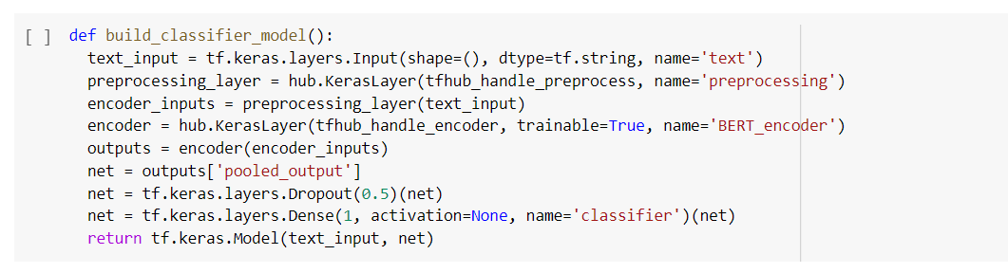
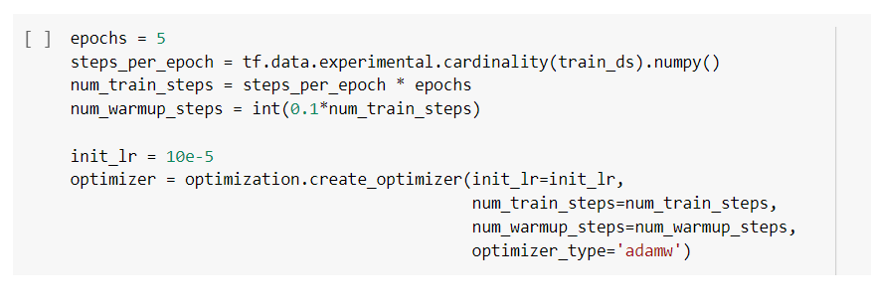
Parameters Tuned
Dropout & Dense
Learning Rate and Epochs

Slide 3
Conclusions from 7/7
Specialized models are the way to go (Eg. SciBERT, Pubmed, etc).
Low values of Dropout are best on TF.
Higher Learning rates are better.
More epochs = better model.

Slide 4


Testing with extended dataset
Bulk Modulus Sentences (desirable)
Sentences with “modulus” and “GPa” keywords
Sentences relating to other chemical properties
Completely Random Sentences
Bulk Modulus of X is Y.
X Modulus of Y is Z.
X Property of Y Chemical is Z.
Random X, Y, Z.

Slide 5
Pubmed 5 epochs, Dropout = 0.05, Dense = 1
 | Bulk Modulus | Modulus and GPa | Other Properties | Random
Sentences | 20 | 20 | 20 | 20
Correct Classifications | 20 | 1 | 19 | 20
Incorrect Classifications | 0 | 19 | 1 | 0
Accuracy | 100% | 5% | 95% | 100%
Overall Accuracy | 75%

Slide 6
Possible causes of high error rates with classifying category 2
Model is trained on positive datasets containing the word “modulus” and “GPa” and thus is unable to discern differences between other types of moduli like Young’s Modulus and Bulk Modulus.
General model does a much better job of classifying category 2 sentences while a much worse job classifying category 1 sentences. This might be because it just does not classify either category 1 or 2 very correctly from the get go.

Slide 7
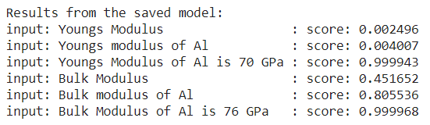
Trying to append the negatives in the dataset
Added 60 sentences (20 about other Moduli, 20 about other properties, 20 random) to test performance.
Correct classification as negative
Incorrect classification, maybe because of number and “Gpa”?
Expected increase towards sentences we want.

Slide 8
Testing Maciej’s dataset of Abstracts
 | Bulk Modulus | Other
Sentences | 25 | 70
Correct Classifications | 3 | 70
Incorrect Classifications | 22 | 0
Accuracy | 12% | 100%
Overall Accuracy | 75.5556%

Slide 9
Possible causes of high error rates with classifying Bulk Modulus Paper Abstracts
Model is trained on positive datasets containing the word “modulus” and “GPa” and thus is unable to categorize abstracts if they do not have atleast a sentence that follows the “The Bulk Modulus of X is Y GPa.”
Just having the bulk modulus keyword does not tell the program that the paper is a paper we might be interested in. A lot of authors do not include their results in the abstract, which is what we would ideally want.

Slide 10
Testing appended model on a random paper
Paper: Bulk Modulus and Structural Phase Transitions of Wurtzite CoO Nanocrystals
DOI: 10.1021/jp067354i
Number of sentences: 74
Number of correctly Identified sentences: 4 (Bulk Modulus Datapoints) and 69 (other)
Number of Incorrectly Identified sentences: 1 (Not Bulk Modulus identified as Bulk Modulus)
Accuracy: 73/74

Slide 11
Used Jasmine’s dataset of 4025 sentences
Had to split datasets into batches of 250 due to RAM issues.
16 sets of ~250 sentences.

Slide 12
Using newest dataset (9.24)
 | Bulk Modulus | Other
Sentences | 22 | 4003
Correct Classifications | 20 | 3982
Incorrect Classifications | 2 | 21
Accuracy | 90.9% | 99.47%
Overall Accuracy | 99.47%
Recall | 0.909
F score | 0.635

Slide 13
Misclassifications
Broad Topic | Number of Sentences
Other Moduli | 3
Thermal Conductivity/Coefficients | 5
Crystallization | 1
Pressure/Strain | 3
Magnetization | 5
Hardness | 1
Enthalpy | 1
Minerals/Chemicals | 3

